Slide 1
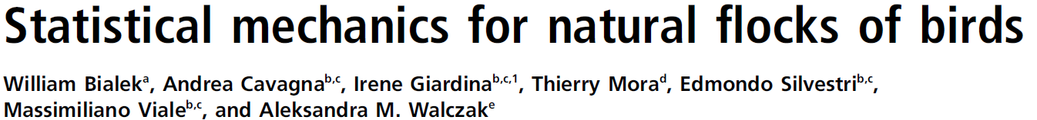




Project;Preparatory School for Stat.Phys
Pedro Ventura Paraguassú PUC-RJ
Victor Valadão UFRJ
Juan I. Pantaleon UBA
Luana Júlia Nunes Ferreira UFAL

Slide 2
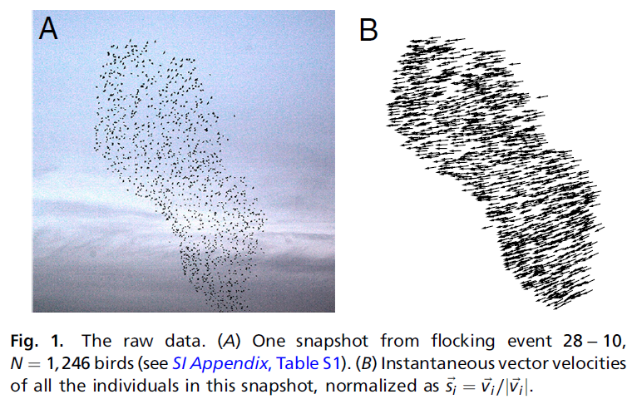
Flock of Starling Birds

Slide 3
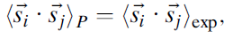
What we can measure from the data?
We define the normalized velocity variables,
which are stationary states, so they have the jointly probability distribution,
We want the probability that fit the data but we want it without make any unnecessary hypothesis on the model.
We can’t obtain the the prob. distribution directly from the data. Instead, we can obtain is the correlation matrix of the normalized velocity, so we want to measure:
there exists a variety of distributions that can be fit by the data, but the minimum structure comes from Maximum Entropy Method .
We just construct the model with the maximum information available!

Slide 4
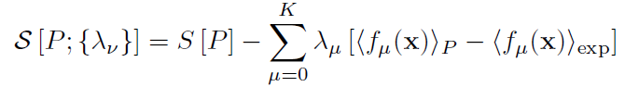
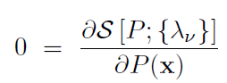
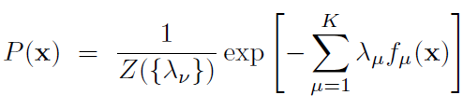
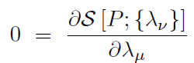
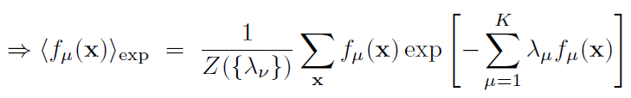
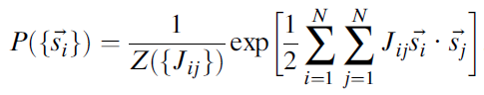
Maximum Entropy Method
To obtain the probability consistent with the data, we need to extremize the Shannon Entropy. In general, the Lagrangian Multiplier of Shannon Entropy:
If we maximize with respect to the probability:
And if we optimize with respect to the multiplier:
In our model, the variables are the correlation, which means we need a multiplier with two indices, the J. At last,

Slide 5
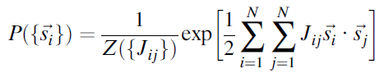
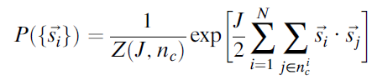
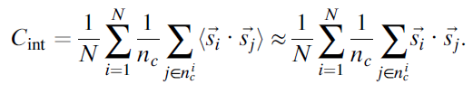
The model
This model is the Heisenberg model of spins, which is good because we know how to deal with the Heisenberg model.
However, we need to make some simplifications due to the change of the bird’s change of neighbours over the time. In this way, it does not make sense to talk about correlation matrix of labeled individuals.
So, we need to suppose that both strength of interaction and the number of neighbours are fixed, from which follows the probability distribution:
Now we need to extract from the data both values of
Another way to do this is to make the maximum entropy method with respect to the average of correlation:
Notes:
Well, this is the model who we will work on it, let’s see what the data says about J, n and other things.

Slide 6
Methods
The data were obtained in the field using stereometric photography and computer vision techniques;
The samples contain 21 distinct flocking events with the amount of 122 to 4268 individuals;
The linear extensions among the starlings were between 9.10m and 85.70m and they use triangulation algorithms to measure it.

Slide 7
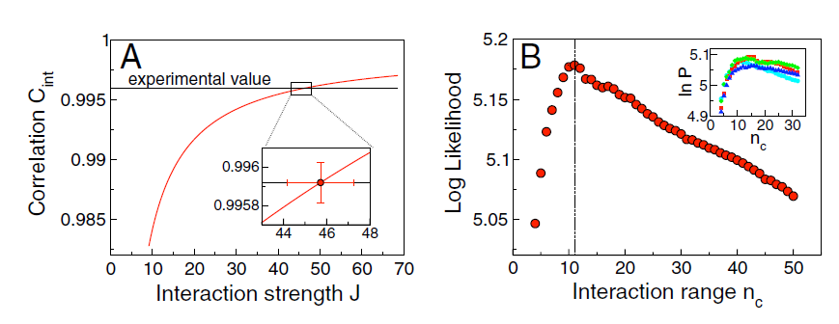
Results
Predicted vs. Experimental Correlation and Maximum Entropy
Find the Nc that maximizes the Shannon Entropy;
Find the correlation value that matches with the found Nc;
Find the correspondent value of J for the correlation;

Slide 8
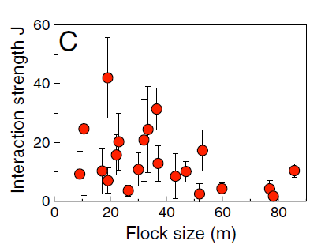
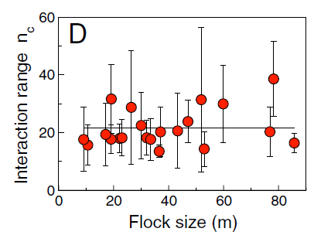
Interaction Strength J and Interaction Range Nc for all flocks
Find an average of Nc for all flocks;
Nc = 21.2 +- 1.7;

Slide 9
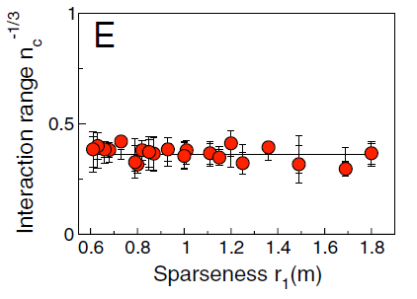
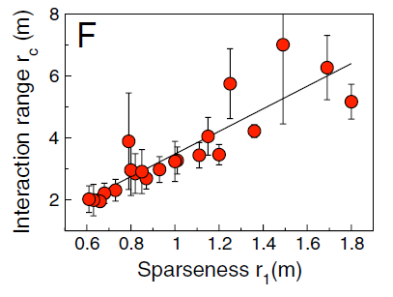
Metric Interaction Range vs. Topological Range
We find the signature of interactions with a fixed number of topological neighbours;

Slide 10
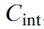
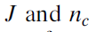
Model Predictions
From a single input:
Fix all the parameters.
Solve the system with the Maximum Entropy Model with:
Fixed flight direction as a boundary condition.
Spin wave approximation.
Calculate any observable from the model.
NOT AS A FIT, BUT AS A PREDICTION!

Slide 11
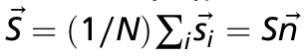
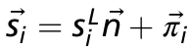
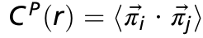
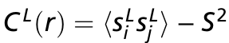
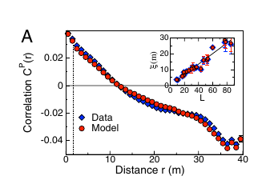
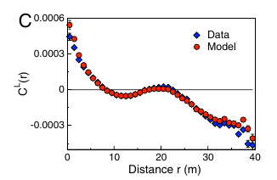
Correlation (L and P) as a function of the distance:
Cavagna A, et al. (2010) Scale-free correlations in starling flocks.Proc Nati Acad Sci USA 107:11865-11870

Slide 12
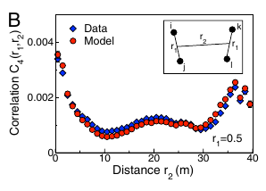
Four point correlation function:
The model has no input about higher order correlation.
Surprisingly reproduce very well the data.

Slide 13
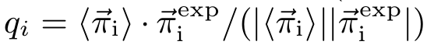
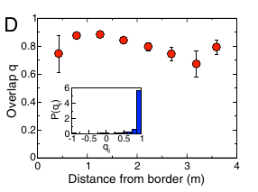
Overlap:
Measures alignment between data velocities and model velocities.

Slide 14
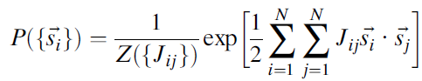
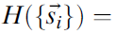
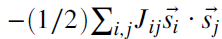
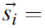
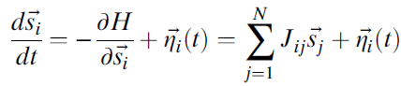
Analogy with Heinsenberg model for spins
the mechanistic interpretation
Maximum entropy model
Heinsenberg model for spins
velocity
directions
- Hamiltonian
spins
Hamiltonian Dynamics
Langevin
dynamics
social
forces
noise
Notes:
Jij strngth of interaction
Jij > 0, elements tend to align

Slide 15
Testing the mechanistic interpretation. Can we take it seriously?
Simulation
Compare
Self propelled particles
Social forces
Microscopic parameters
J_{sim} n_{sim}
simulation inputs
Maximum entropy model
J_{mem} n_{mem}
just like withe the real data

Slide 16
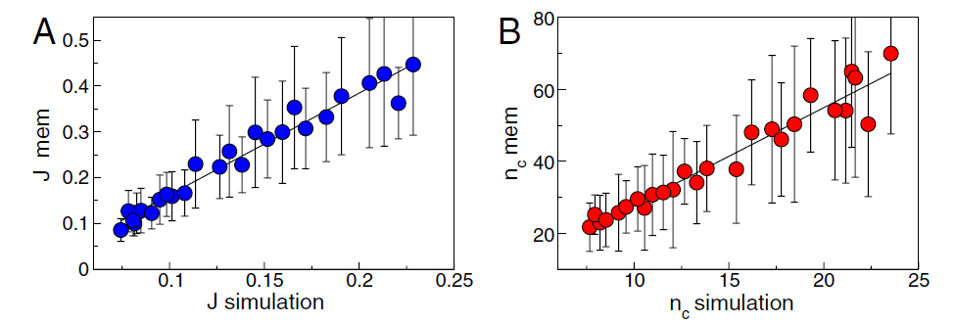
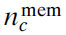
proportional values, not equal ~ 3 x
Observed in real flocks (mem)
True interactions
2
Calibration

Slide 17
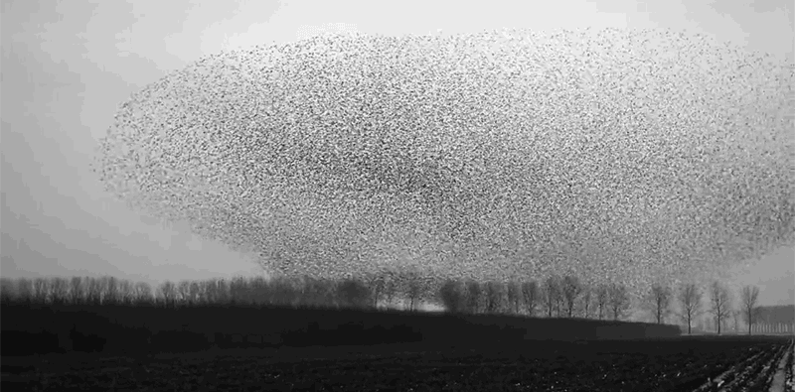
Thank you
Thank you !

Slide 20
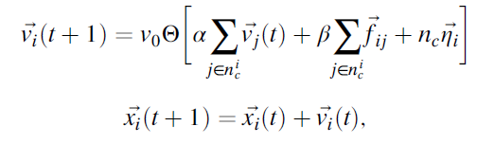
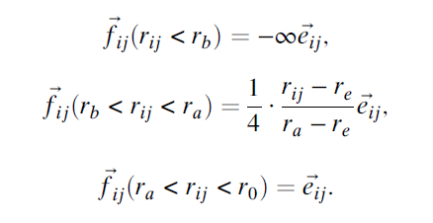
simulation model

Slide 21
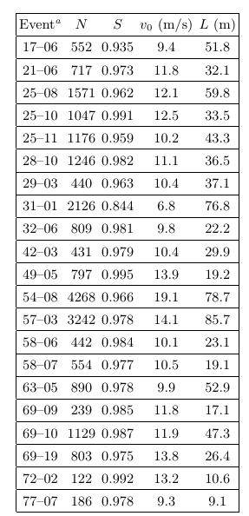
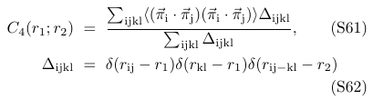
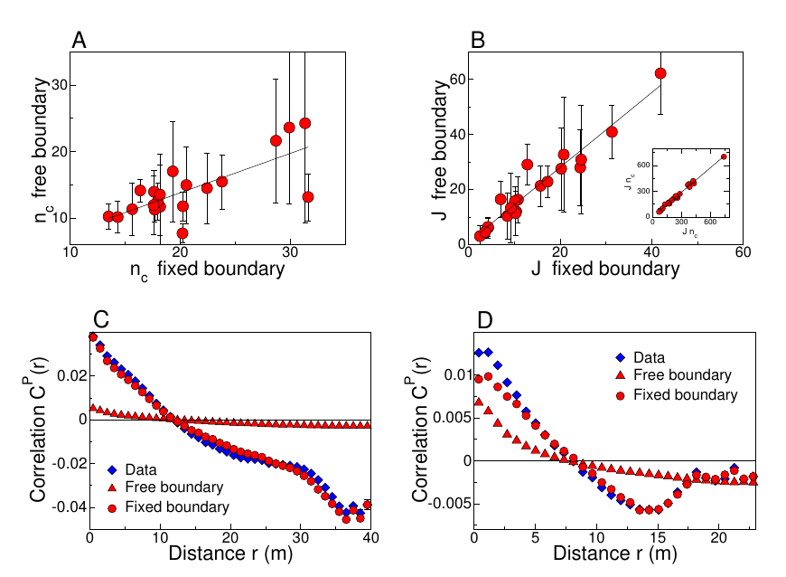
Additional Material:
Experimental data:
4 Bird correlation:

